Slide 1
Progress report for pNet
Yuncong Ma, 10/2023

Slide 2
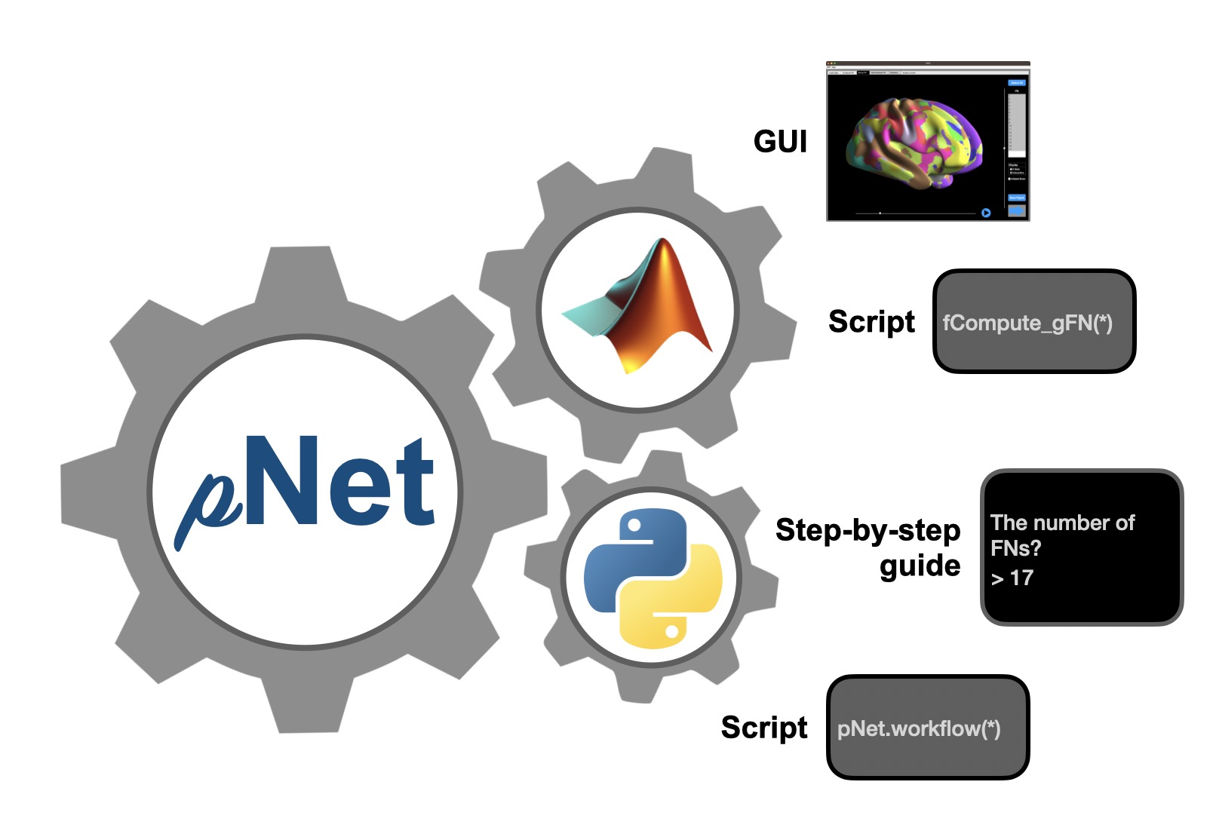
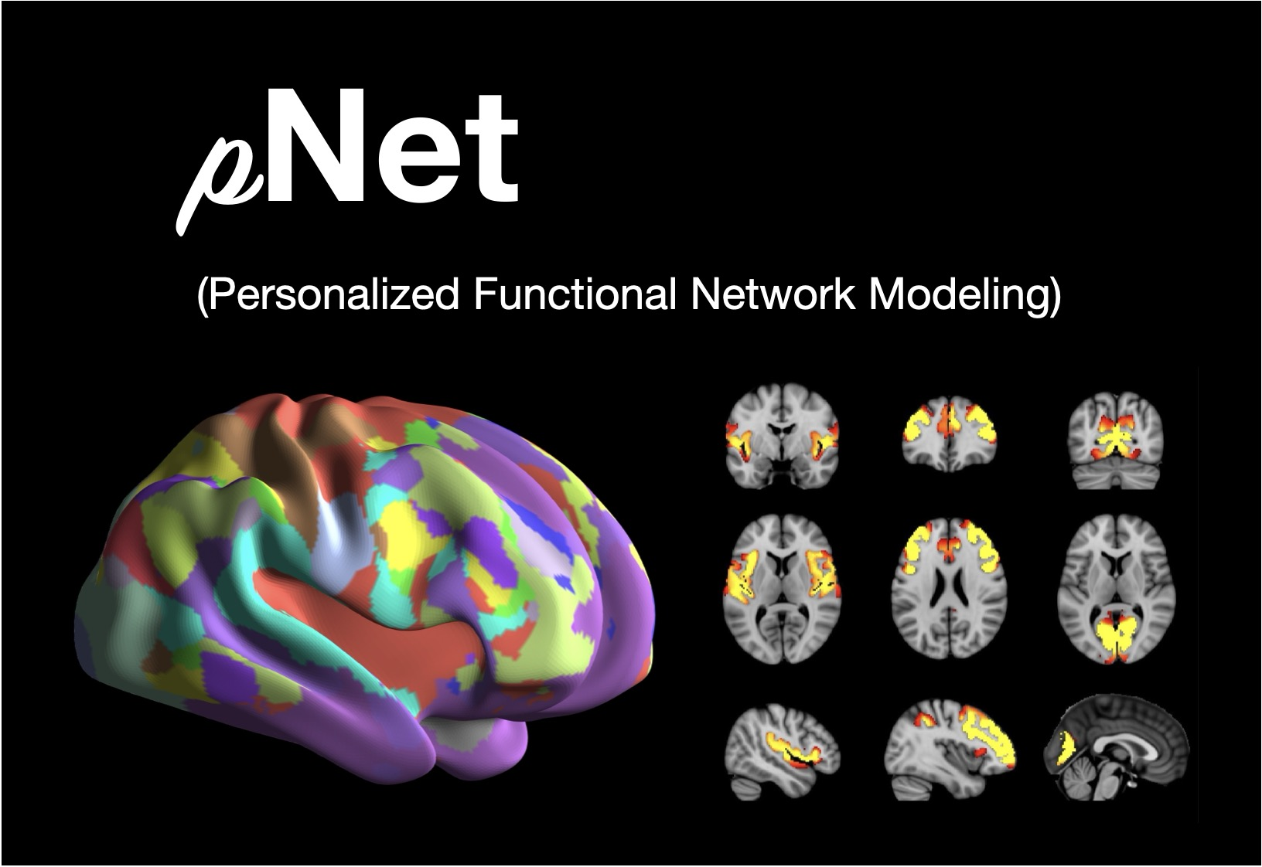
Personalized functional network modeling (pNet)
A toolbox to model brain functional networks using functional MRI
It provides cross-compatibility in MATLAB and Python
A GUI version is designed in MATLAB
A step-by-step guide is available for Python users

Slide 3
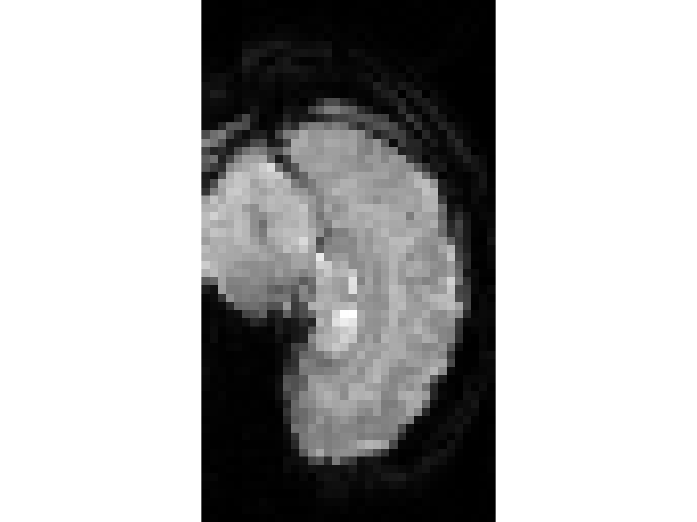
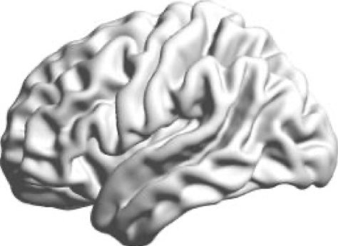
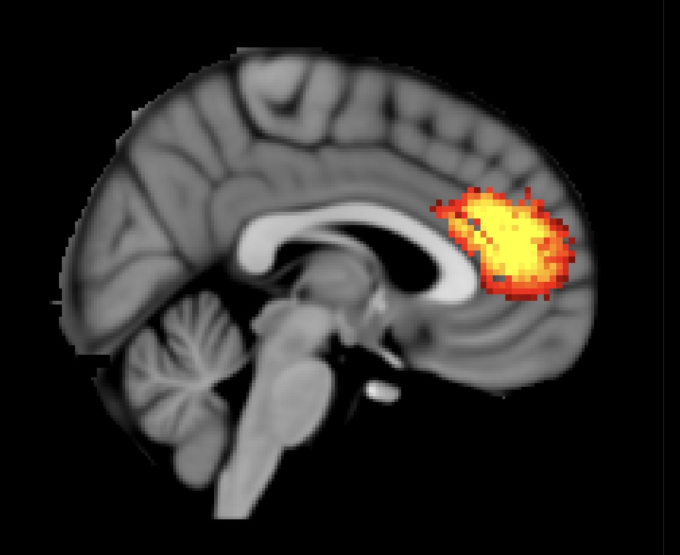
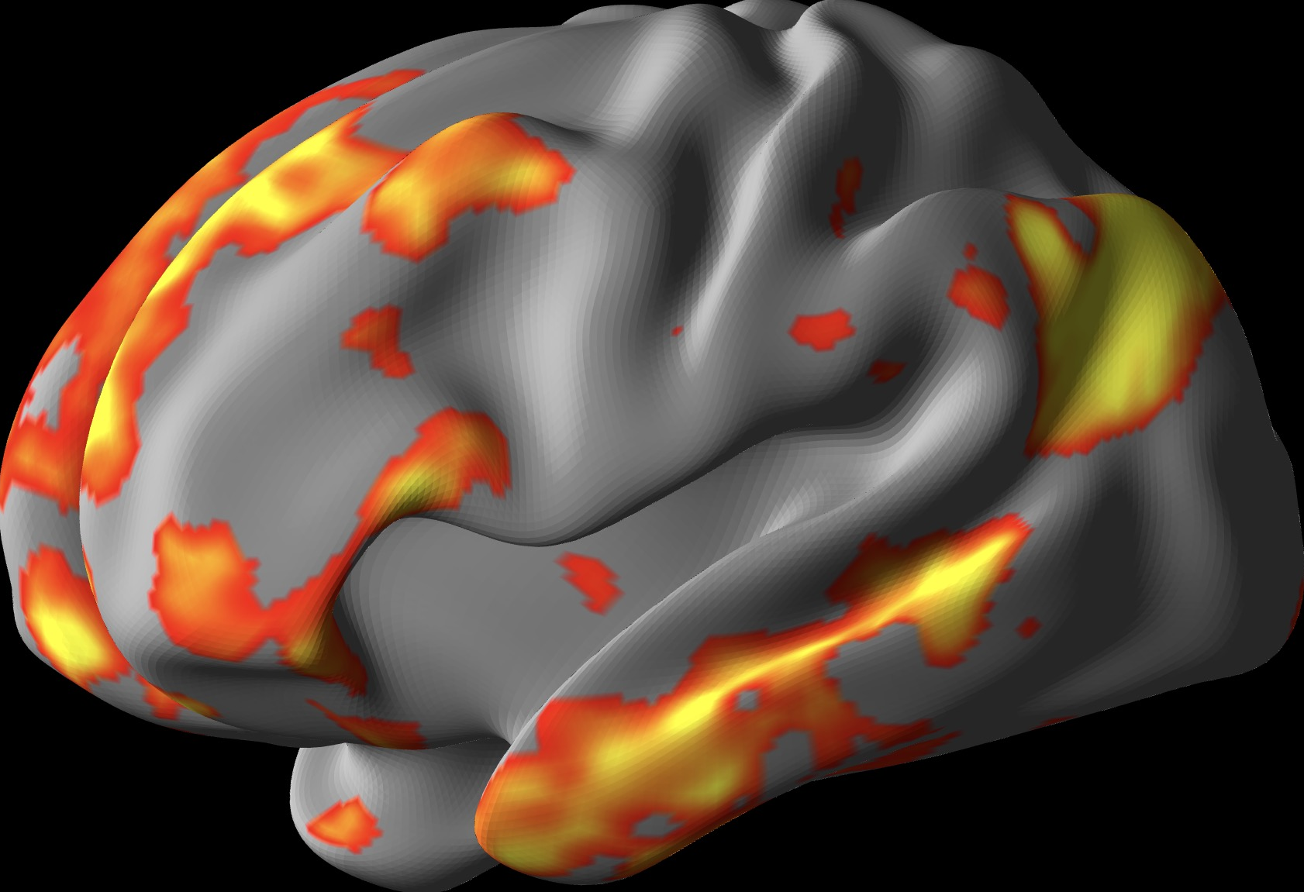
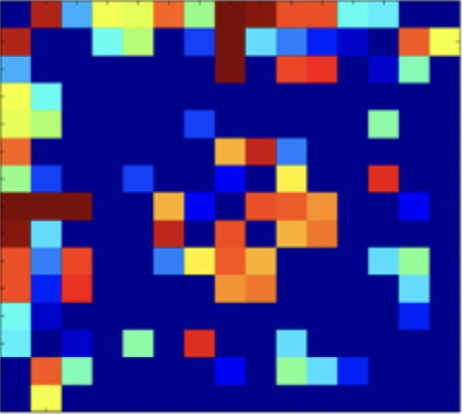
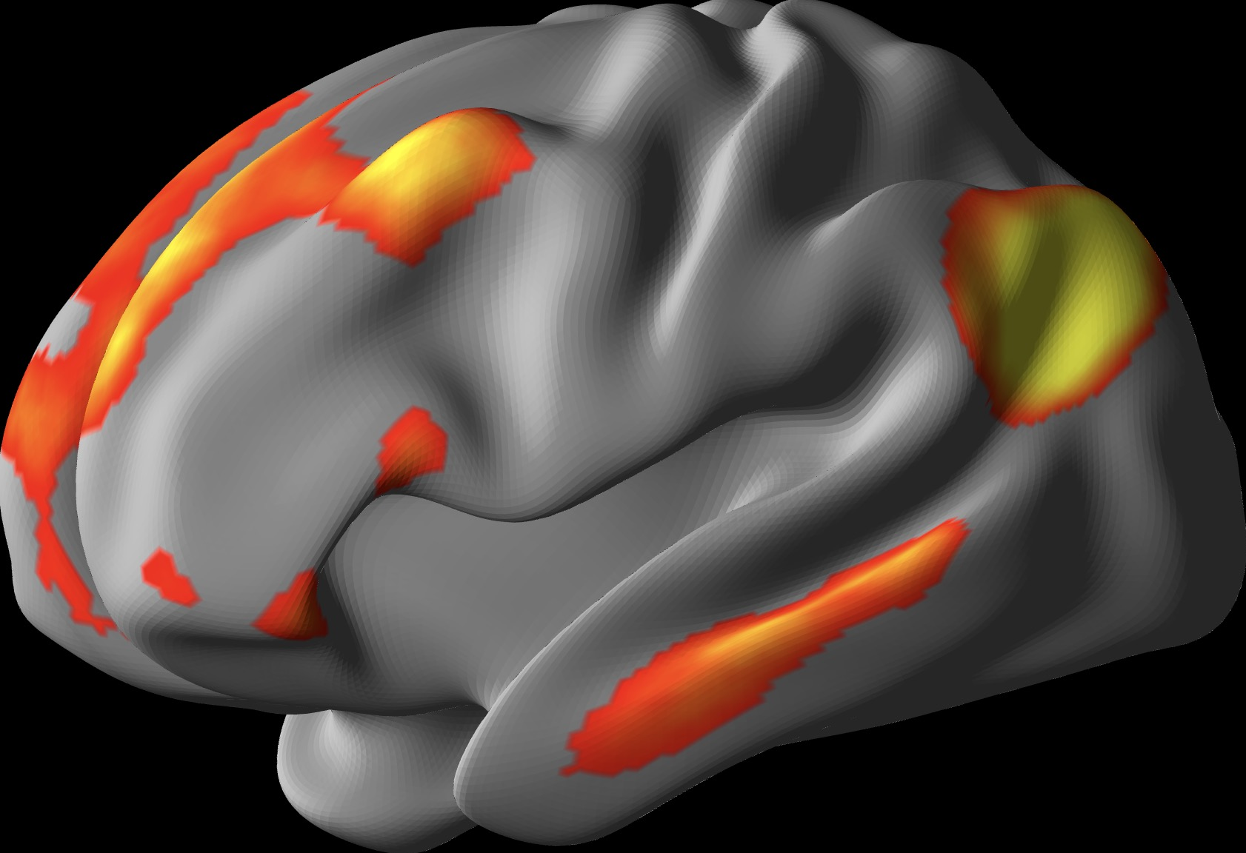
Flowchart
Five main modules with a customizable workflow
Data Input
Volume fMRI
t
Surface fMRI
t
Multiple formats (NIFTI, CIFTI, MGH, MGZ, MATLAB)
FN Computation
Spatial-regularized Non-negative Matrix Factorization (NMF)
Personalized FNs
Visualization
Topography
Functional connectivity
Volume
Surface
FC matrix
Quality Control
gFNs
Match
pFNs
Spatial correspondence
Functional coherence
Statistics
Significance in pFNs
Relationships to behaviors
Age ~ pFNs

Slide 4
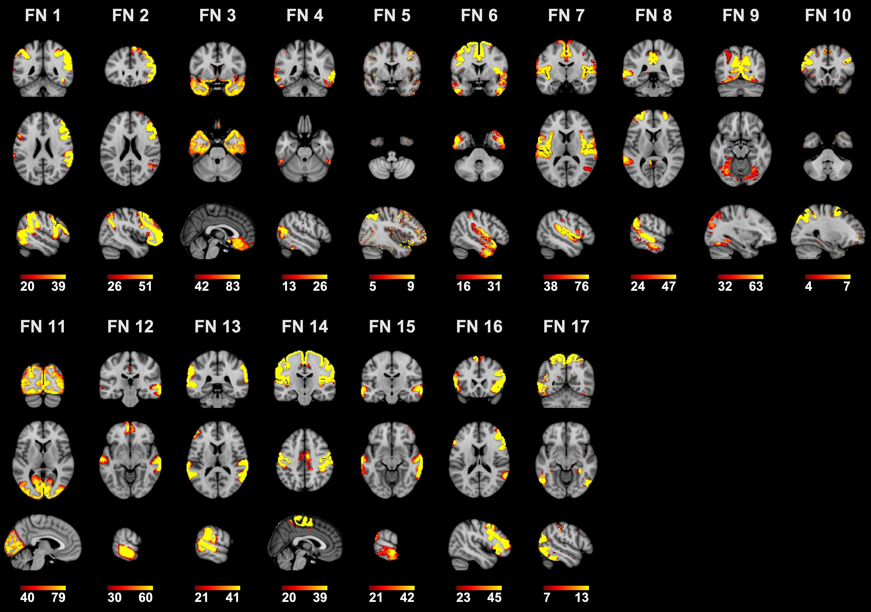
Example results
17 functional networks obtained from UKBB dataset
Each subject has its own personalized functional networks

Slide 5
Toolbox availability
GitHub: https://github.com/MLDataAnalytics/pNet and https://github.com/YuncongMa/pNet.

Slide 6
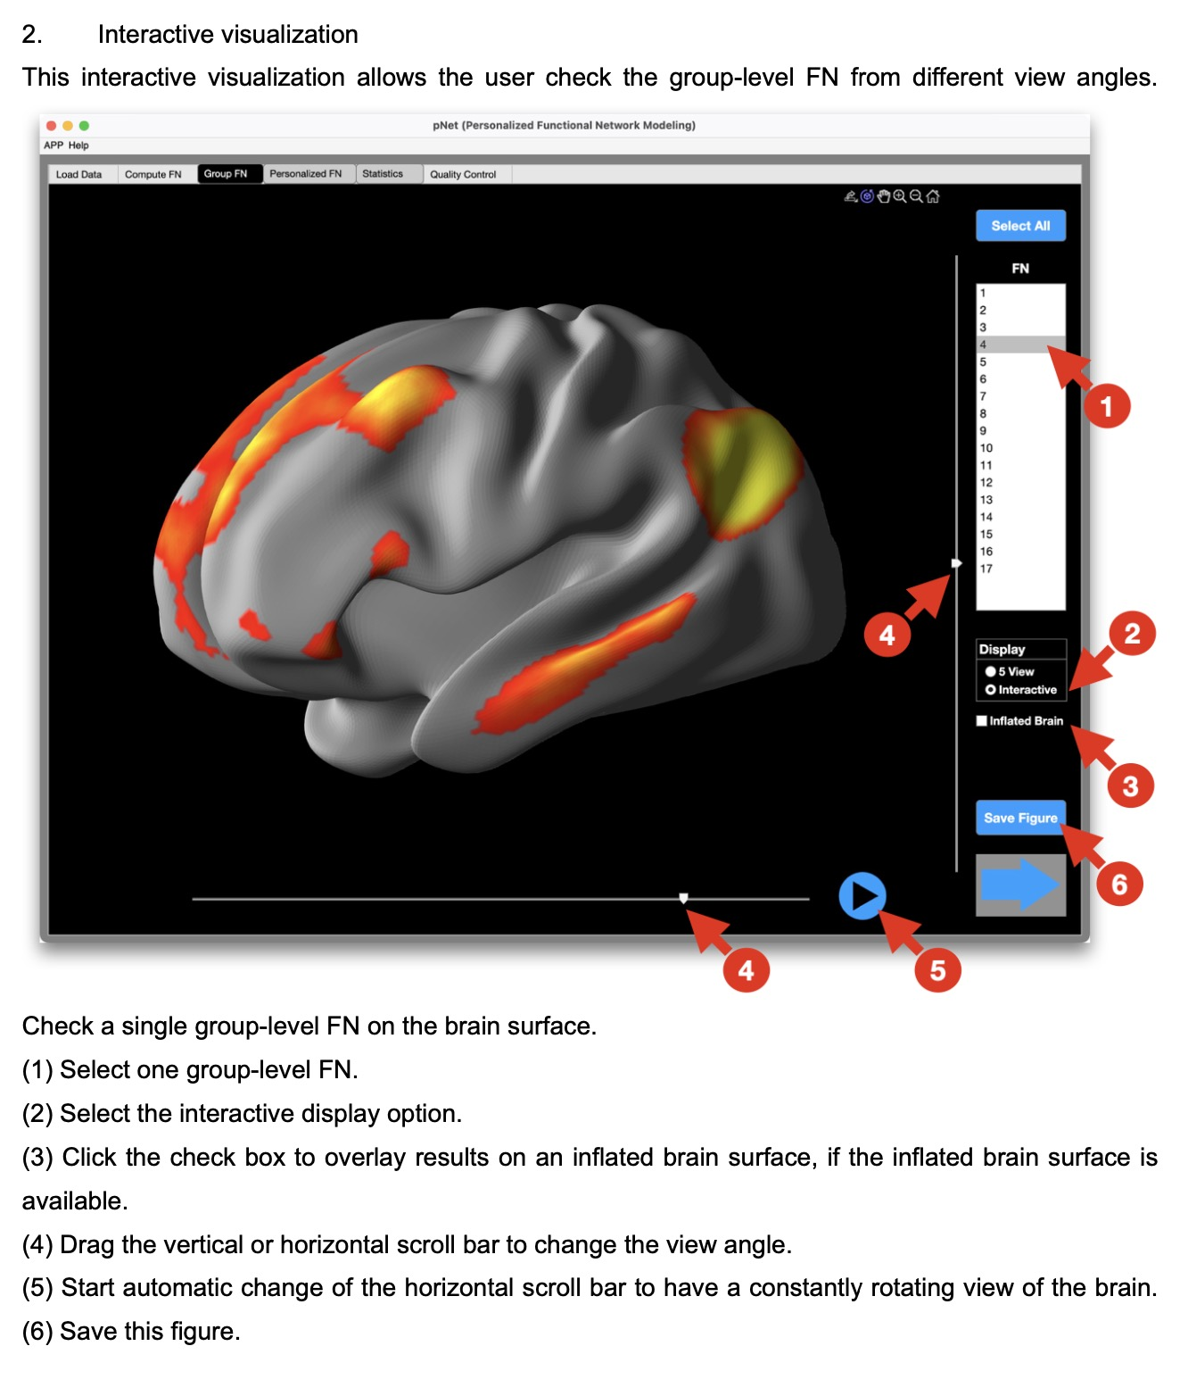
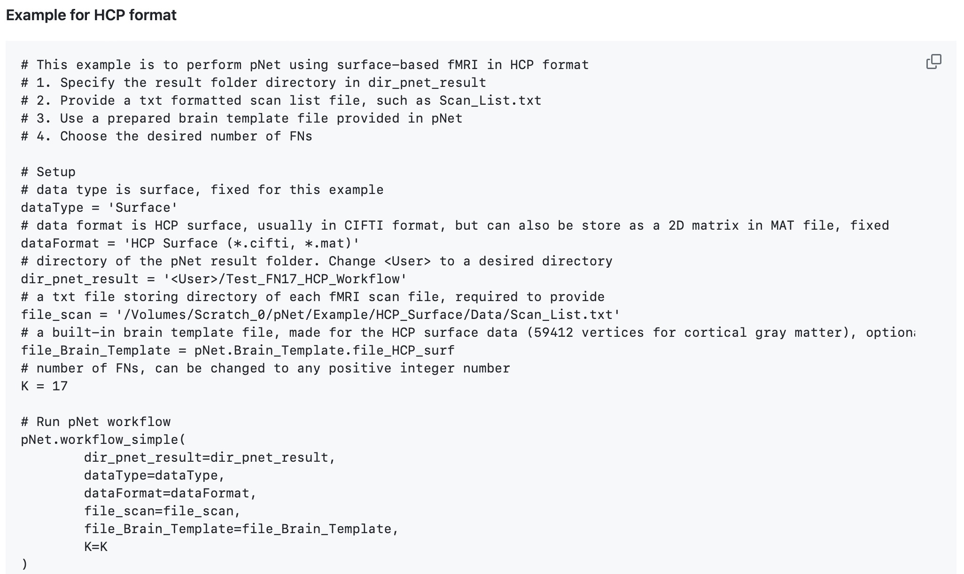
Manual
Example scripts
Video tutorial
Step-by-step guide in command line

Slide 7
Publications
Ma, Y., Li, H., Zhou, Z., Chen, X., Ma, L, Fan, Y., pNet: A toolbox for personalized functional networks modeling, in preparation.
Zhou, Z., Li, H., Srinivasan, D., Abdulkadir, A., Nasrallah, I.M., Wen, J., Doshi, J., Erus, G., Mamourian, E., Bryan, N.R., Wolk, D.A., Beason-Held, L., Resnick, S.M., Satterthwaite, T.D., Davatzikos, C., Shou, H., Fan, Y., Consortium, I., 2023. Multiscale functional connectivity patterns of the aging brain learned from harmonized rsfMRI data of the multi-cohort iSTAGING study. Neuroimage 269, 119911.
Li, H., Satterthwaite, T.D., Fan, Y., 2017. Large-scale sparse functional networks from resting state fMRI. Neuroimage 156, 1-13.
Li, H., Satterthwaite, T., Fan, Y., 2016. Identification of subject-specific brain functional networks using a collaborative sparse nonnegative matrix decomposition method. 2016 IEEE 13th International Symposium on Biomedical Imaging (ISBI), pp. 984-987.

Slide 8
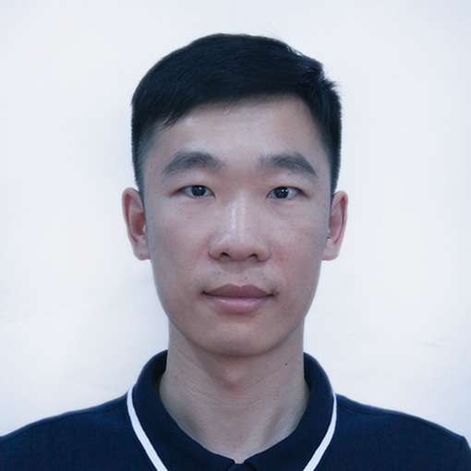
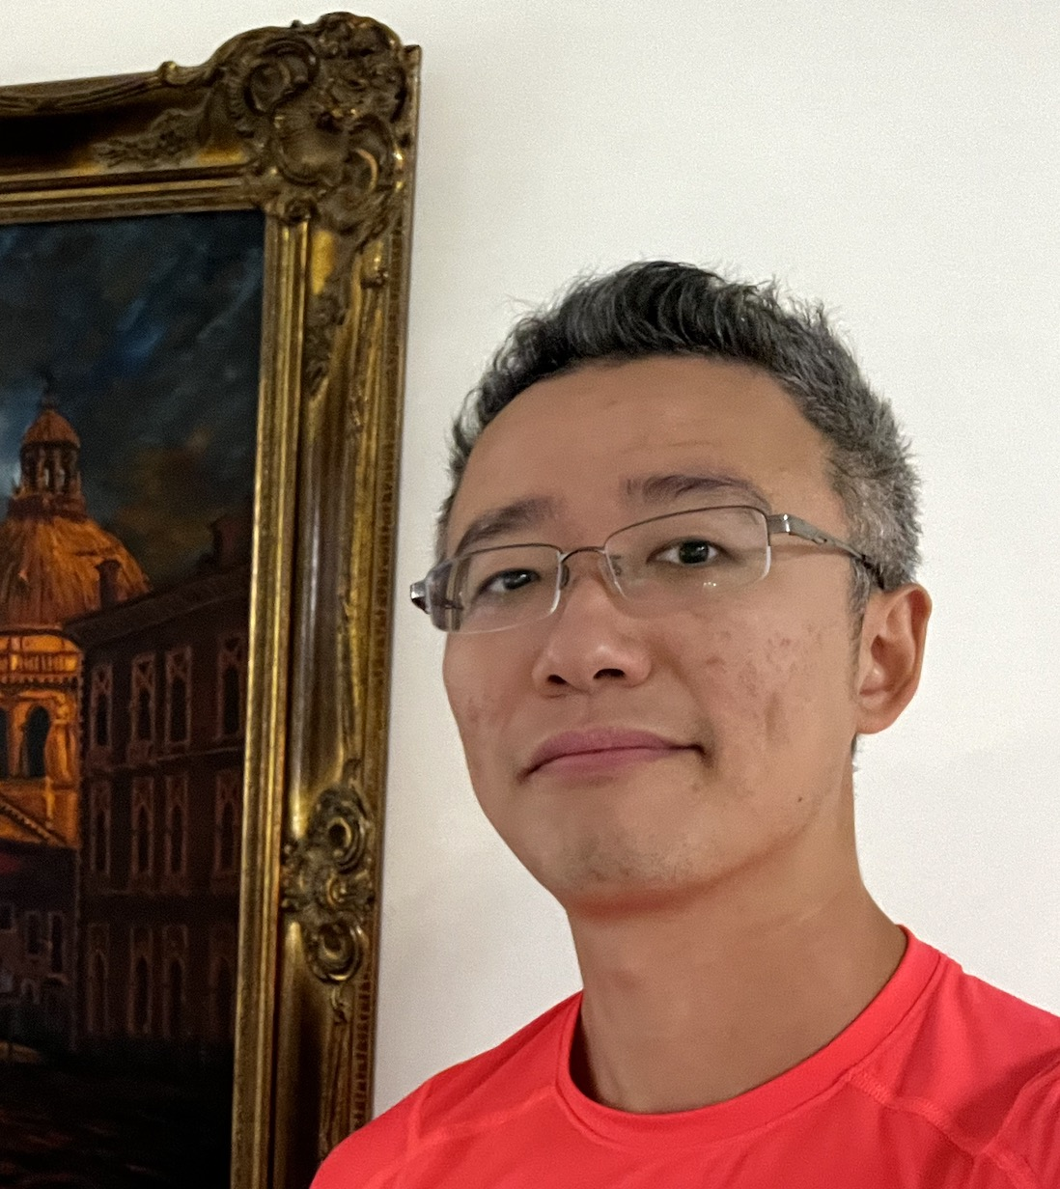
Team members
Hongming Li
Senior Research Investigator
https://github.com/hmlicas
Yuncong Ma
Post doc
https://github.com/YuncongMa
@YuncongMa

